Slide 1

Democracy in the EU

Slide 2
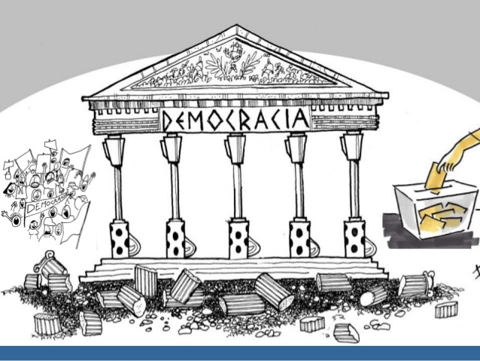
Concept of DEMOCRACY
Government by the people (s V a.c., Athens)
Government in which the supreme power is vested in the people and exercised by them directly or indirectly through a system of representation usually involving periodically held free elections.

Slide 3
PILLARS of DEMOCRACY
FREEDOM
PARTICIPATION
RESPECT OF HUMAN RIGHTS
RULE OF LAW

Slide 4

PILLARS of DEMOCRACY

Slide 5
Why the EU should guarantee DEMOCRACY?
Article 2 TUE establishes the values of the Union:
HUMAN DIGNITY FREEDOM
DEMOCRACY
EQUALITY RULE OF LAW
HUMAN RIGHTS
Article 3 TUE establishes the main objectives of the Union.

Slide 6
European instruments for guaranteeing DEMOCRACY
BASIC LEGISLATION:
European Charter of fundamental rights. 2000
European Convention on Human Rights. 1950
TOOLS:
Court of Justice of the EU
European Court of Human Rights (Council of Europe)
Fundamental Rights Agency
EXTERNAL POLICY
EU Special Representative for Human Rights
European instrument for democracy and human rights (EIDHR)

Slide 7
RISKS FOR DEMOCRACY
Legitimation of power?
Abuse of power?
No respect of human rights?

Slide 8
VIDEOS
Education for democracy in 10 steps (video COE)
https://www.youtube.com/watch?v=3i8HaFA5EYg&list=PLMD_RYvUcCYn-xGX5mWJqS0jzDdKPgaWP&index=14
Introduction of Democracy
https://www.youtube.com/watch?v=u6jgWxkbR7A
So similar, so different, so European
https://www.youtube.com/watch?v=9jXeRU5w5l8

